Slide 1
Wat Duang Dee Web Application
function

Slide 2
The users can view a temple’s history
Users can view a temple’s history page of the temple’s website

Slide 3
Step for work
1. The system shall provide a control (e.g. menu bar) for users to choose.
2. Users click “History” button.
3. The system shall retrieve the temple’s history from the database.
4. The system shall provide the temple’s history page for users.

Slide 4
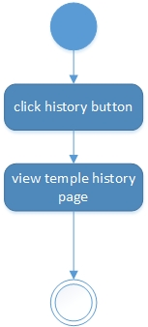
Activity Diagram

Slide 5
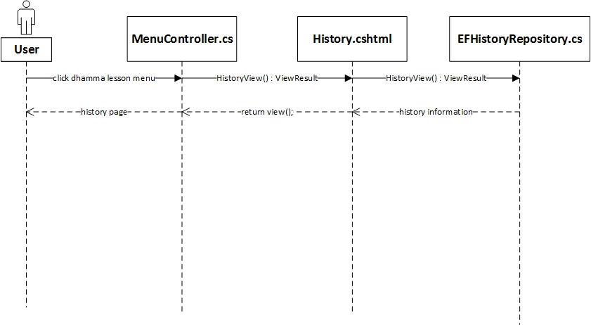
Sequence Diagram

